Slide 1

Education and Edtech
AI in the education field
By Armin Hamedian

Slide 2

Problem Statement
Primary school teachers often spend an excessive amount of time on manual grading and administrative tasks such as uploading results into Compass and identifying student learning gaps. These repetitive processes reduce the time available for lesson planning and personalized teaching.

Slide 3

AI - Solution
We are developing an AI-powered MCP tool that integrates directly into the teacher workflow. The system allows teachers to:
Upload student work (text, images, or bulk class submissions).
Receive AI-generated grades, progress reports, and recommendations aligned to the Victorian Curriculum.
Use a custom rubric management system to define their own assessment criteria, making grading flexible and aligned with individual teaching styles.
Seamlessly upload results to Compass and other school platforms, saving hours of administrative time.
The ultimate goal is to empower teachers with better insights into student learning while reducing their administrative burden.

Slide 4
User Stories and Workflow Demo
User Story 1: Individual Assessment Marking
As a teacher, I want a quick way to analyze student’s work so I can get an idea of their Strengths and Weaknesses, so I can better understand their work and provide better feedback (e.g., in Parent Teacher Interviews) without spending hours grading.
1.
Open AI progress Tracker
2.
Navigate to Individual Analysis Tab
3.
Enter Student Details
4.
Select Assessment type
5.
Enter / Upload student Work
6.
Click Analyze Work
7.
Receive AI generated feedback
8.
Click Upload to compass

Slide 5
User Stories and Workflow Demo
User Story 2: Bulk Upload for a Class
As a teacher, I want to grade my class at once (on small tests), so I can spend more time teaching the students and have all results ready for upload to Compass
1.
Navigate to Bulk Upload
2.
Add Student
3.
Enter Student details and work
4.
Enter Assessment type
5.
Repeat the 2 step above as needed
6.
Click Analyze Work
7.
Receive AI generated Grade
8.
Adjust Accordingly and click Bulk Upload

Slide 6
User Stories and Workflow Demo
User Story 3: Rubric adjustment
As a teacher, I want to be able to create my own rubrics, so I can get the AI to grade based on criteria that match my expectation and teaching style for that Assignment.
Navigate to Rubric Management
Select a Rubric / Create a new Rubric
Enter Rubric Name (reference)
Press Add Criteria
Enter Criteria Details
Press “Save Rubric”
Return to Individual or Bulk analysis
Repeat Step 1 – 5
Select Rubric From “Assessment Rubric”
Repeat the rest of the Steps

Slide 7

Current Status of the Project
The UX interface is developed: teachers can navigate through tabs, upload work, and view AI-generated reports.
The rubric management and grading system is working in-browser, storing rubrics and generating detailed, criteria-based feedback.
The AI simulation works realistically but is not yet connected to a real AI backend.
Integration wit real Education tools such as Compass are designed but not yet implemented.

Slide 8
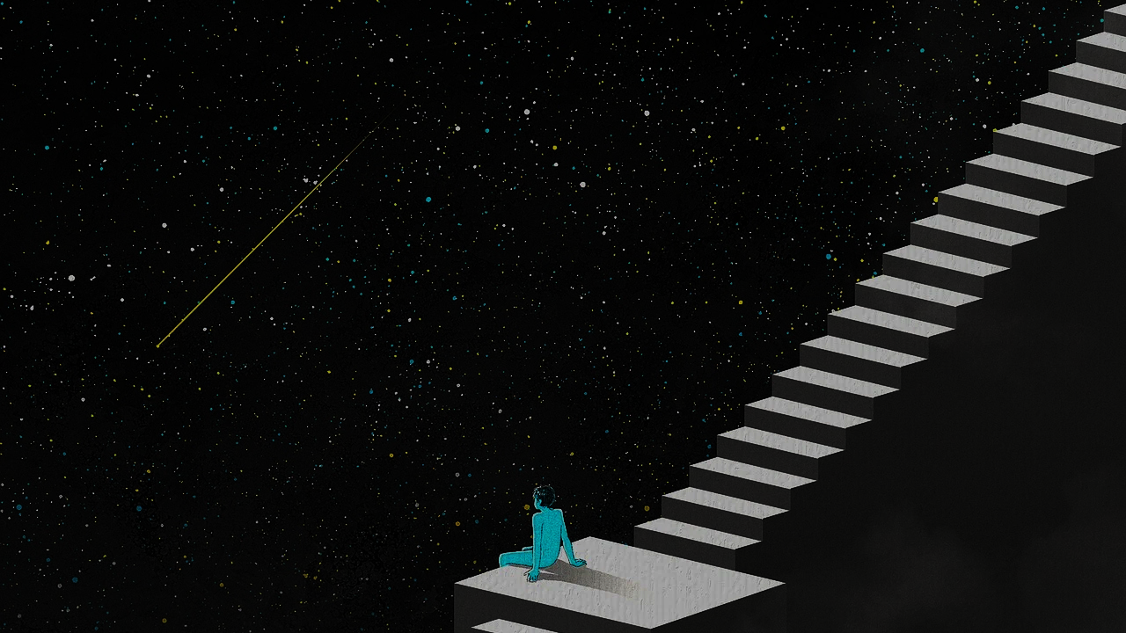
Possible Future Direction of the Project
Real AI integration with NLP models for authentic grading and feedback.
Full Compass and LMS (Google Classroom, MS Teams) integration for seamless workflows.
Data dashboards for principals to monitor class and school-wide performance, even further an average for Department of Education
Predictive analytics to flag students at risk early and recommend targeted interventions.
Option to send Feedback directly to parents and guardians past just to compass.

Slide 9

Handover
Our group has completed the research and working prototypes. Some of the Next steps for future teams could be:
Research the backend services that could connect the prototype to real AI models.
Research secure data storage and role-based access controls.
Implement Extra Features such as sending Grades to Supervisor
Expand the rubric engine to support shared templates across schools.
Conduct teacher pilot testing to gather usability and adoption feedback

